Slide 1

Hackathon
Feb 2008
DVD Prices
Mikel Ward
<mward@aconex.com>

Slide 2
What I set out to achieve
Retrieve DVD prices from online stores
  Got hooked on West Wing then prices went up
Store them in my library web site
  Existing framework for items I own
Send an email when a DVD is on special
  Or meets a user-defined target price
Do it using PHP 5 OO and Propel ORM
  Inspired by Ruby on Rails and
  No Framework PHP MVC Framework

Slide 3
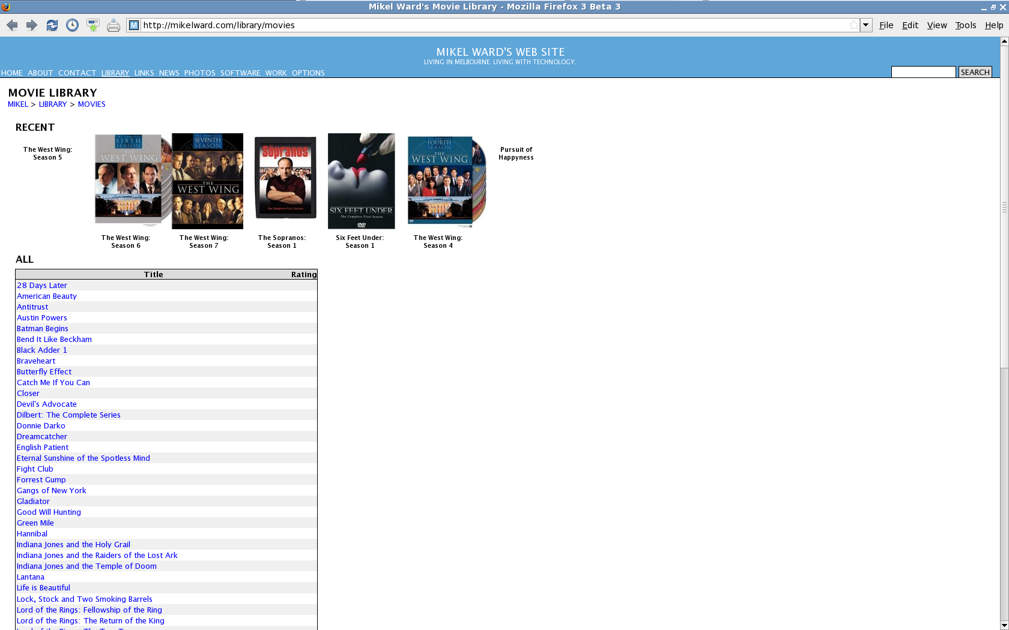
My Library

Slide 4
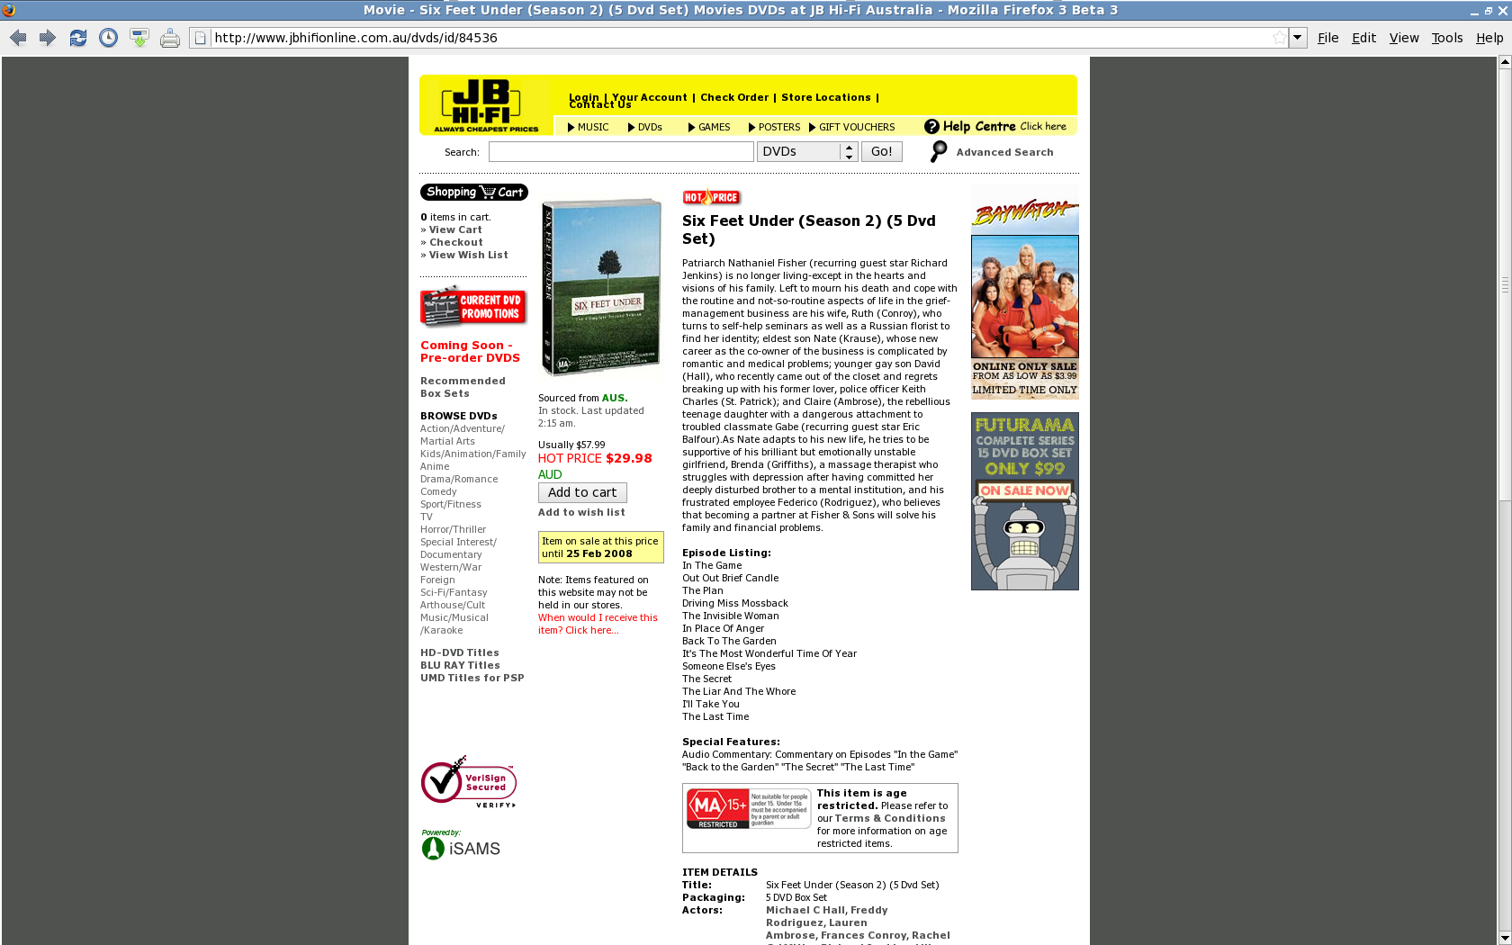
JB Hi-Fi Web Site

Slide 5
Problems encountered
Unfamiliarity with Propel ORM
No obvious way to subclass without DB
Web server requiring Host header
  This didn't work:
  GET /dvds/id/855245 HTTP/1.0
  This did:
  GET /dvds/id/855245 HTTP/1.0
  User-Agent: Wget/1.10.2 (Red Hat modified)
  Accept: */*
  Host: www.jbhifionline.com.au
  Connection: Keep-Alive
  IIS 6.0, possibly shared/virtual hosting

Slide 6
Best solution
Added Store and StoreItem classes
Generate JBHiFiOnline using “factory”
Use PHP HttpRequest rather than fopen
Cache HTML files locally
Extract prices using preg_match
  /class="itemPriceRed".*?\$([0-9.]+)/
  Mmm... Semantic Web
Sort columns using sorttable.js

Slide 7
Propel schema 1
<table name="stores" phpName="Store">
<column name="store_id" type="INTEGER" primaryKey="true" required="true" autoIncrement="true"/>
<column name="name" type="VARCHAR" size="64" required="true"/>
<column name="country_id" type="INTEGER"/>
<foreign-key foreignTable="countries">
<reference local="country_id" foreign="country_id"/>
</foreign-key>
<column name="homepage_url" type="VARCHAR" size="255"/>
<column name="class_key" type="INTEGER" inheritance="single" required="true">
<inheritance key="1" class="JBHiFiOnline" extends="library.Store"/>
</column>
</table>

Slide 8
Propel schema 2
<table name="store_items" phpName="StoreItem">
<column name="store_id" type="INTEGER" required="true"/>
<foreign-key foreignTable="stores">
<reference local="store_id" foreign="store_id"/>
</foreign-key>
<column name="item_id" type="INTEGER" required="true"/>
<foreign-key foreignTable="items">
<reference local="item_id" foreign="item_id"/>
</foreign-key>
<column name="store_item_id" type="INTEGER" primaryKey="true" required="true"/>
<column name="price" type="INTEGER"/>
<column name="view_url" type="VARCHAR" size="255"/>
</table>

Slide 9
Generated database
items
+---------+-----------+-------------------------+
| item_id | class_key | title |
+---------+-----------+-------------------------+
| 12 | 2 | Aliens |
| 13 | 2 | The West Wing Season 2 |
| 14 | 2 | Adaptation |
| 15 | 2 | Red Dwarf Season 1 |
| 16 | 2 | Six Feet Under Season 2 |
+---------+-----------+-------------------------+
store_items
+----------+---------+---------------+-------+
| store_id | item_id | store_item_id | price |
+----------+---------+---------------+-------+
| 1 | 12 | 1087537 | 2699 |
| 1 | 13 | 85736 | 3297 |
| 1 | 14 | 80138 | 1998 |
| 1 | 15 | 78394 | 4699 |
| 1 | 16 | 84536 | 2998 |
+----------+---------+---------------+-------+

Slide 10
Store “factory”
class Store extends BaseStore
{
static public function getStore($store_id)‏
{
if ($store_id == StorePeer::CLASSKEY_JBHIFIONLINE) {
return new JBHiFiOnline();
}
else {
throw new Exception("Unknown store id $store_id");
}
}
}

Slide 11
User API
  $movie = new Movie();
  $movie->setTitle($title);
  $movie->save();
  $itemId = $movie->getItemId();
  if (!empty($_POST['jbid'])) {
    $storeItem = new StoreItem();
    $storeItem->setStoreId(StorePeer::CLASSKEY_JBHIFIONLINE);
    $storeItem->setItemId($itemId);
    $storeItem->setStoreItemId($_POST['jbid']);
    $storeItem->update(); // gets the price, etc.
    $storeItem->save();
  }

Slide 12
User API 2
$store = new JBHiFiOnline(); // or the user's preferred store
foreach ($movies as $movie) {
  $movieId = $movie->getItemId();
  $title = $movie->getTitle();
  $critera = new Criteria();
  $criteria->add(StoreItemPeer::STORE_ID, $store->getClassKey(),
  CRITERIA::EQUAL);
  $criteria->add(StoreItemPeer::ITEM_ID, $movie->getItemId(),
  CRITERIA::EQUAL);
  $storeItems = StoreItemPeer::doSelect($criteria);
  $storeItem = storeItem[0];
  $price = $storeItem->getPrice();
  print(“<tr><td>$title</td><td>$price</td></tr>”);
}

Slide 13
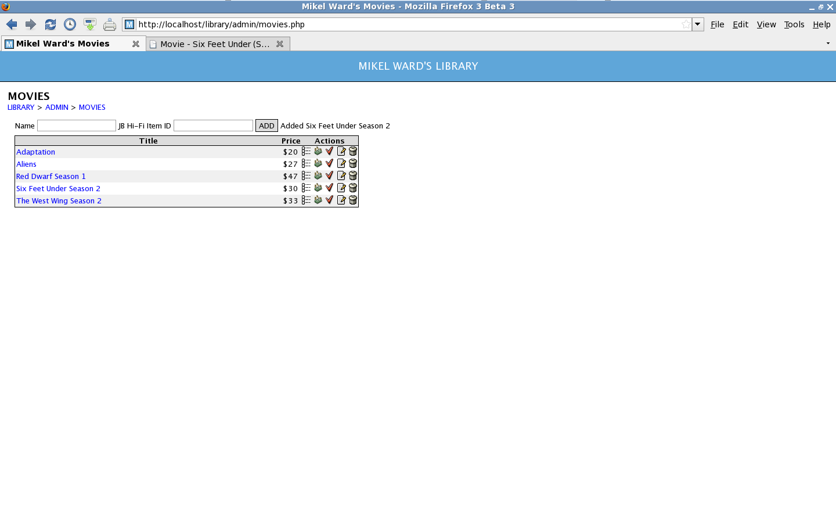
New Wishlist Page with Prices!

Slide 14
Next steps
Make StoreItem a subclass of Item
Allow entering a desired price
Run a daily script to send emails
Add other stores
  Amazon has a SOAP API
  Others will be harder/hackier
Find store item ID from my library
(no need to go to store site to add item)‏
Add books, CDs, games, etc.

Slide 15
Further information
mikelward.com/library
propel.phpdb.org
tinyurl.com/n7aox (“No framework MVC”)‏
pecl.php.net/package/pecl_http
kryogenix.org/code/browser/sorttable
SVN repo access on request

Slide 16
Questions
Any questions or thoughts?

